Slide 1
GRAPH ANALYSIS USING STOCK MARKET SIMULATOR
NIKHIL SK AND PRAMILA DALVAI

Slide 2
TABLE OF CONTENTS

Slide 3
CONTENT
OUTPUT
DESIGN TOOLS
Implementing the code using Javasdk’s and many other platforms to get the application as result
OVERVIEW
Notifies you about the various tool used to build the high level design software
PROBLEM
Deals with the project flow and how the programs are integrated
JavaFx Desktop Application which allows users to view up-to-date financial data.
ABSTRACT
OVERVIEW
HIGH LEVEL DESIGN
TOOLS USED
RESULT AND OUTPUT

Slide 4
ABSTRACT
STOCK MARKETS
A stock market, equity market or share market is the aggregation of buyers and sellers of stocks (also called shares), which represent ownership claims on businesses; these may include securities listed on a public stock exchange, as well as stock that is only traded privately, such as shares of private companies which are sold to investors through equity crowdfunding platforms.
A stock market simulator is a program or application that attempts to reproduce
the features of a live stock market on a computer so that the user can get
trading stocks without financial risk. It replicates a live stock data and allows
users to create virtual trading platform. This application is designed for
user interface using JavaFX and graph building to represent the
stock market.
34%
13%
75%
STOCK HOLDINGS
TRADING RATE
PARTICIPATION
Largest stock market was the United States
Stock trading rate is increasing rapidly over the years
Almost 75% of business background class people invest in the markets

Slide 5
PROBLEM STATEMENT
JavaFx Desktop Application which allows users to view up-to-date financial data and analyze it with the help of graphs.

Slide 6
INTROUDCTION AND OVERVIEW
MAVEN
In order to enable flexible way to configure XML configurations, manage Rest endpoints we
created Maven dependency Project. Dependency management is a core feature of Maven.
Managing dependencies for a single project is easy. Managing dependencies for multimodule projects and applications that consist of hundreds of modules is possible
ADD DEPENDANCIES
Maven helps a great deal in defining, creating, and maintaining reproducible builds with well-defined classpaths and library versions.
SPRING BOOT
After deciding the dependencies, we created a Spring Project using Spring Initializer. The Initializer offers a fast way to pull in all the dependencies you need for an application and does a lot of the setup for us.
AMZN
AAPL
IBM
STOCK API
$120
$90
$210
The Real-time-stock-data is found using Alpha Vantage Financial Api provider. This suite of APIs provide realtime and historical global equity data in different temporal resolutions

Slide 7
APPLICATION DESIGN
Building an application
TOOL USED
JAVAFX APPLICATION
AND ITS JAR FILES
JAVAFX
APPLICATION
JavaFX is a software platform for creating and delivering desktop applications, as well as rich Internet applications (RIAs) that can run across a wide variety of devices. JavaFX is intended to replace Swing as the standard GUI library for Java SE, but both will be included for the foreseeable future.JavaFX has support for desktop computers and web browsers on Microsoft Windows, Linux, and macOS.
SELL
BUY

Slide 8
GRAPH ANALYSIS
BUY
SELL
STOCK
ACCURACY

Slide 9
Infographic Style
IN-DEPTH ANALYSIS
Thought process
Study markets
Strategize
Right choice
Global scope
Find the right stock

Slide 10
HIGH LEVEL DESIGN
1. Java Library
It is a Java library which consists of many classes
pom.xml
2. Built in UI controls
JavaFX contains Built-in components which are not dependent on operating system. The UI component are just enough to develop a full featured application.
mvn : clean
mvn : install
3. Rich Set of APIs
JavaFX provides a rich set of API's to develop GUI applications.
MAVEN REPOSITORY

Slide 11
TOOLS USED
1
Spring Boot
Spring Boot Initializer
Spring Boot is an open source Java-based framework used to create a micro Service. It is
developed by Pivotal Team and is used to build stand-alone and production ready spring
applications.
2
The Spring Initializer is ultimately a web application that can generate a Spring Boot project structure for you. It doesn't generate any application code, but it will give you a basic project structure and a Maven build specification to build your code with
3
JSON editor and plugin
JAVAFX jar files
It allows us to create JSON files and thereby allows us to read the file.
4
Helps to build the application as it contains all the essential libraries.
5
Alpha Vantage Finance API
Okhttp Library
Open source data provider which provides stock data of over 20+ years
6
Library used to set up http connection with the open source api url in order to retrieve the data.

Slide 12
GAINS OF THE ANALYSIS
RIGHT ACTION(BUY/SELL)
SELECTION OF RIGHT STOCK
GRAPH ANALYSIS

Slide 13
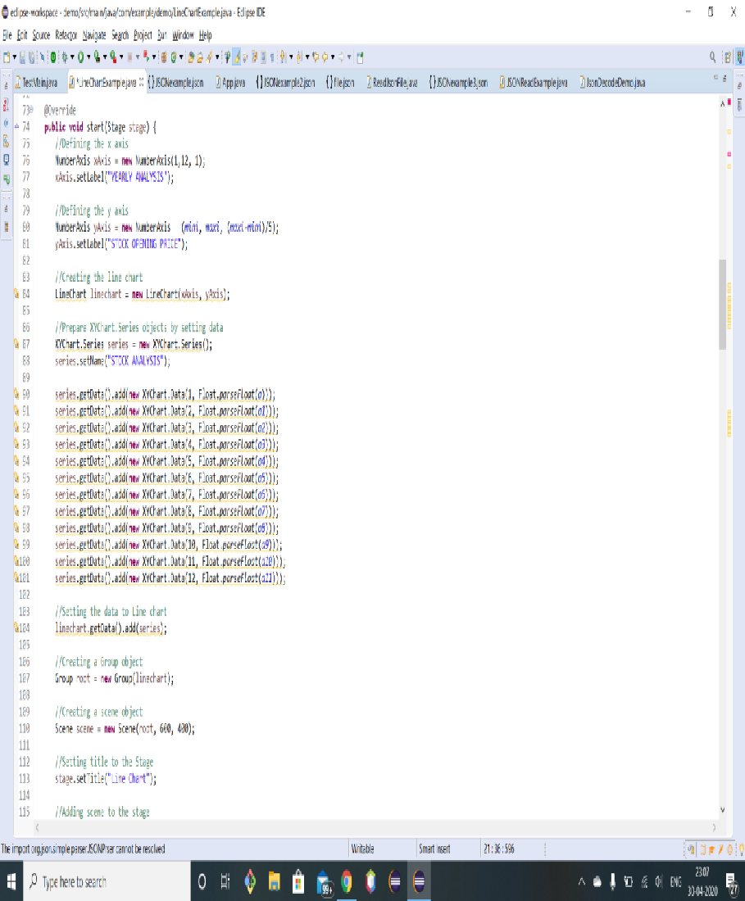
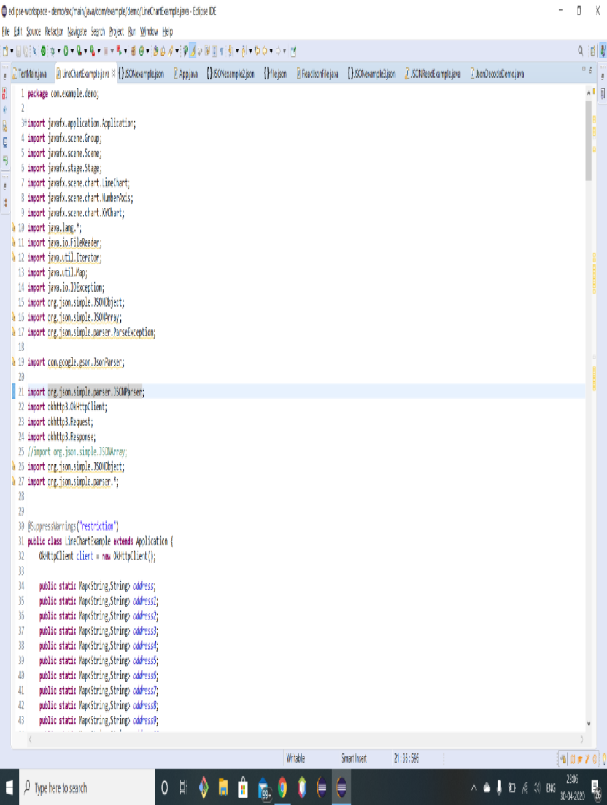
CODE

Slide 14
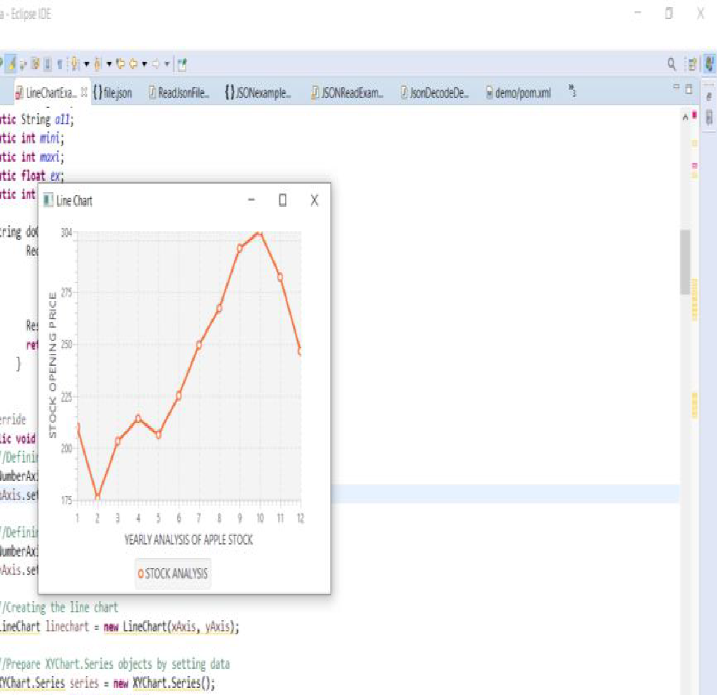
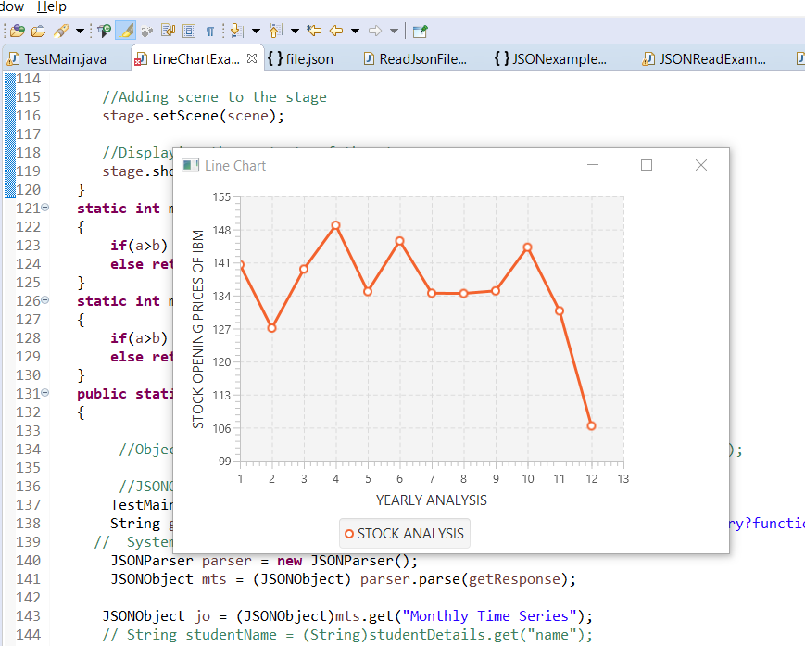
RESULTS

Slide 15
REFERENCES
http://maven.apache.org/guides/introduction/introduction-to-dependency-mechanism.html
https://www.tutorialspoint.com/spring_boot/spring_boot_introduction.htm
https://mvnrepository.com/
https://spring.io/projects/spring-boot
https://start.spring.io/
https://www.alphavantage.co/documentation/
https://square.github.io/okhttp/
https://openjfx.io/

Slide 16

Thank You

